Slide 1
CS 418
Introduction To Data Science
Final Project
Karan Malhotra
Sharat Naik
Shreya Chandwadkar

Slide 2

PROBLEM STATEMENT
Identify the parameters that can affect or determine the rating of an app on the Google Play Store or predict ratings for new apps.
Perform Linear Regression and document our observations.
Sentiment analysis on the reviews provided for apps from the first dataset, to predict whether an unseen review would be positive or negative.
Data Source
Link: https://www.kaggle.com/lava18/google-play-store-apps

Slide 3
DATA CLEANING
Dropped Android Ver, Last Updated, Current Ver
Removed duplicate rows having same App names
Removed data with 0 reviews, 0 installs or null ratings
Retained the first genres from a list of genres for an app
Cleaned the Installs column
Convert size to one uniform format
Convert categorical variables to numerical variables
Convert Price to numerical

Slide 4
LINEAR REGRESSION
After converting the Genre and Content attribute to dummy variables and changing other attributes to either float or int, we performed Multiple Linear Regression Model on the dataset.
We created a train size of 75% and tested our linear regression through multiple combinations of variables. The best R^2 value we could obtain was 0.046. However, with the MSE value of 0.25 we can say that the ratings predicted by the model can be taken as approximate values in the starting step of predicting the ratings of the new apps.
We came to the conclusion that predicting the rating based on these parameters was not apt.

Slide 5
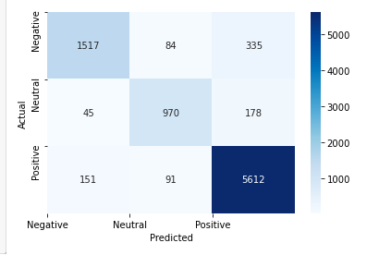
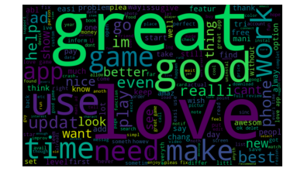
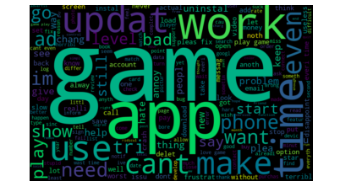
SENTIMENT ANALYSIS
Data needed initial cleaning:
Convert case to lower and remove punctuation and special characters.
Remove stop words, numbers from the data.
Stemming the words to their root form.
Creating a matrix of vectors of words using tfidvectorizer.
Used logistic regression model to predict the sentiment of data as Positive, negative and neutral.
Obtained the accuracy score of 93% and below shown are the contingency matrix and word clouds.

Slide 6
CONCLUSION
Having tested with multiple linear regression models, we came to a conclusion that predicting the rating based on these parameters was apt. The rating of the app on the Play Store depends on a lot more than just the category, number of reviews, installs, the price and the genre of the app. It has to do more with the quality and usability of the app. However with the MSE value of 0.25 we can say that the ratings predicted by the model can be taken as approximate values in the starting step of predicting the ratings of the new apps.
We can conclude that our model performed very well with a 93 percent Score to classify the reviews as negative and positive. We also built word cloud using positive and negative reviews for better visualization.

